Slide 1
Hibernate
Week 11 Faculty Session on Hibernate and Databases

Slide 2
Agenda - Hibernate
Introduction to Hibernate
What is Hibernate?
Advantages of Hibernate
Object to relational mapping (ORM)
Setup Hibernate in Eclipse
Required software's
Setting up Hibernate in Eclipse
Steps to develop Hibernate
Create Hibernate configuration file (XML)
Annotate Java Class
Develop Java code for database operations
Configure Hibernate
What is Hibernate configuration file (XML)?
Adding Hibernate config. file in Java (practical demonstration)

Slide 3
Agenda - ORM
Annotate Java class
What is entity class?
Ways of mapping
Java annotations

Slide 4
Agenda - Practical demonstration of CRUD application
Hibernate
Creating and saving Java objects
Requirements to develop java code for database operations.
Code for Session Factory and Session
Save Java object.
Retrieving a Java object with Hibernate
Updating a Java object with Hibernate.
Deleting a Java object with Hibernate.

Slide 5
Agenda - Concepts related to Important DB concepts
Advanced mappings
Basic mapping
Advanced mapping
One-to-one mapping
One-to-many mapping
Many-to-many mapping
Important database concepts
Keys - Primary , foreign
Cascade
Fetch types
Uni, bi directional
Entity lifecycle
Entity operations

Slide 6
Java JDBC

Slide 7
Overview
JDBC stands for Java Database Connectivity.
Standard Java API for java application and Databases connectivity.
JDBC Architecture contains
JDBC API
JDBC Driver API

Slide 8
JDBC Architecture
Java Application
JDBC Driver Manager
JDBC Driver
(PostgreSQL)
JDBC Driver
(Oracle)
JDBC Driver
(MySql)
PostgreSQL Database
Oracle Database
MySql Database

Slide 9
Steps to Connect to Database
Import JDBC packages
Load and Register the JDBC Driver
Create a connection
Create a statement object to perform a query
Execute the statement object & return a query resultset.
Close the resultset
Close the connection.

Slide 10
Some Common issues with JDBC
Repeatable Code
Repeating the same lines of code over and over again in application for fetching data from the database?
Database Dependency
JDBC is database-dependent, which means that different scripts must be written for different databases.
Exception Handling
Because JDBC throws checked exceptions, such as SQLException, we must write it in a try-catch block.
Migration
Too much of rework while migrating from one database to another.
Managing Associations
When associating database tables in a query with JDBC, we need to write out the full SQL query, while with JPA, we simply use annotations to create one-to-one, one-to-many, many-to-one, and many-to-many associations.

Slide 11
Java Persistence API (JPA)
The Java Persistence API (JPA) is a standard API for accessing databases from within Java applications. The main advantage of JPA over JDBC (the older Java API for interacting with databases) is that in JPA data is represented by classes and objects rather than by tables and records as in JDBC. Using plain old Java objects (POJO) to represent persistent data significantly simplify database programming.
A JPA implementation (sometimes referred to as a JPA provider) is needed in order to interact with a relational database such as Oracle, DB2, SQL Server or MySQL. The popular JPA implementations are Hibernate, TopLink, EclipseLink, Open JPA and DataNucleus. These implementations are Object Relational Mapping (ORM) tools. The mapping bridges between the data representation in the relational database (as tables and records) and the representation in the Java application (as classes and objects).

Slide 12
Introduction to Hibernate

Slide 13
What is Hibernate?
Hibernate is used to save java objects or user data given to java in database for future use.
“Internally",Hibernate uses JDBC (Java Database Connectivity) API and follows its standards to create SQL queries to store data in database.
Java
App
HIBERNATE JDBC DB

Slide 14
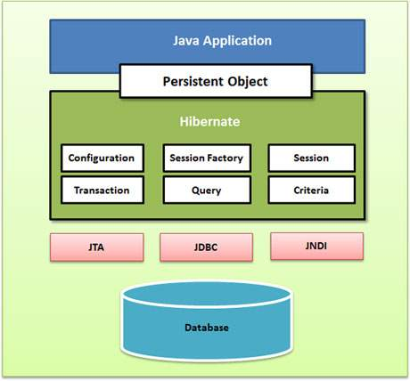
Hibernate Application Architecture

Slide 15
Advantages of Hibernate
Hibernate handles all the low level SQL code when saving data in database.
Minimizes the writing of JDBC code when developing.
Hibernate also provides object to relational mapping (ORM).
Unlike JDBC Hibernate connects with the database itself and uses HQL (Hibernate Query Language) to execute the queries and then it maps the results to the Java objects.
The results are mapped to objects based on the properties given in the Hibernate configuration XML file/Annotation.
The database connection from an application is created using session which also helps in saving and retrieving the persistent object.
Session factory is an interface which helps to create an instance of a session. There must be only one session factory per database. For example, if you are using MySQL and ORACLE in your application, one session factory for MySQL and one session factory for ORACLE is maintained. There will not be more than one session factory per MySQL alone.

Slide 16
Object to relational mapping (ORM)
Mapping java class to database table is called object to relational mapping.
One to one Mapping.
Ways to do map:
Java XML configuration file // old approach
(OR)
Java annotations // modern approach
Teacher
-id: int -f_name: String -l_name: String -email: String
Teacher
id: INT f_Name: VARCHAR (50) l_Name: VARCHAR (50) email: VARCHAR (50)
Indexes
Hibernate
Notes:
we will discuss ways to map in further lectures. Just introducing them to learners

Slide 17
Setup Hibernate in Eclipse

Slide 18
Required softwares
JDK ( Hibernate 5.2 & above requires atleast JDK 8)
Java integrated development environment (IDE)
Database server
Hibernate JAR files and JDBC driver

Slide 19
Setting up Hibernate in Eclipse
Create Eclipse project
Download Hibernate Files (hibernate.org)
Download MYSQL JDBC driver (www.mysql.com/downloads)
Add JAR files to Eclipse project … Build Path

Slide 20
Configure Hibernate

Slide 21
What is Hibernate configuration file (XML)?
Config file
Hibernate
-- -- -- -- -- -- -- --
-- -- -- -- -- -- -- --
-- -- -- -- --
JDBC

Slide 22
<!DOCTYPE hibernate-configuration PUBLIC
"-//Hibernate/Hibernate Configuration DTD 3.0//EN"
"http://www.hibernate.org/dtd/hibernate-configuration-3.0.dtd">
<hibernate-configuration>
<session-factory>
<!-- JDBC Database connection settings -->
<property name="connection.driver_class">com.mysql.cj.jdbc.Driver</property>
<property name="connection.url">jdbc:mysql://localhost:3306/hibernate_crud</property>
<property name="connection.username">root</property>
<property name="connection.password">admin</property>
<!-- JDBC connection pool settings ... using built-in test pool -->
<property name="connection.pool_size">1</property>
<!-- Select our SQL dialect -->
<property name="dialect">org.hibernate.dialect.MySQL5Dialect</property>
<!-- Echo the SQL to stdout →
<property name="show_sql">true</property>
<!-- Set the current session context →
<property name="current_session_context_class">thread</property>
<property name="hibernate.hbm2ddl.auto">update</property>
</session-factory>
</hibernate-configuration>

Slide 23
ORM - Annotate Java class

Slide 24
What is entity class?
The Java class that is map to database table is called entity class.
Teacher
-id: int -f_name: String -l_name: String -email: String
Teacher
id: INT f_Name: VARCHAR (50) l_Name: VARCHAR (50) email: VARCHAR (50)
Indexes
Hibernate

Slide 25
Java annotations
Step 1: Map Class to database Tables
@Entity
@Table(name = “teacher”)
public class Teacher{
…
...
}
teacher
id: INT f_Name: VARCHAR (50) l_Name: VARCHAR (50) email: VARCHAR (50)
Indexes
Teacher
-id: int -f_name: String -l_name: String -email: String

Slide 26
Java annotations
Step 2: Map fields to Database Columns
@Entity
@Table(name = “teacher”)
public class Teacher{
@Id // indicates primary key
@Column (name = “id”)
private int id;
@Column (name = “f_Name”)
private String f_name;
….
….
}
Teacher
-id: int -f_name: String -l_name: String -email: String
Teacher
id: INT f_Name: VARCHAR (50) l_Name: VARCHAR (50) Email: VARCHAR (50)
Indexes

Slide 27
Agenda - Practical demonstration of CRUD application
Hibernate
Creating and saving Java objects
Requirements to develop java code for database operations.
Code for Session Factory and Session
Save Java object.
Retrieving a Java object with Hibernate
Updating a Java object with Hibernate.
Deleting a Java object with Hibernate.

Slide 28
Requirements to develop Java code for database operations
Session Factory:
Reads config file and connects to database.
Creates session and session objects.
Create Session Factory only once and use multiple times.
Session:
a. Used to save or retrieve objects from database.
b. Session is an object like java class object.

Slide 29
Code for Session Factory and Session
SessionFactory factory = new Configuration()
.configure(“hibernate.cfg.xml”)
.addAnnotatedClass(Teacher.class)
.buildSessionFactory();
Session session = factory.getCurrentSession();

Slide 30
Save Java object
Steps to save Java object
S. No | To Do | Code
1 | Create class object | Teacher teacher= Teacher( f_name, l_name, email);
2 | Begin transaction | session.beginTransaction()
3 | Save the object | session.save(teacher)
4 | Commit the transaction | session.getTransaction.commit()

Slide 31
Retrieving Java object with Hibernate
// Create Java object
Teacher teacher = new Teacher(f_name, l_name, email);
// save it to database
session.save(theTeacher);
// retrieving/reading from database using id
Teacher tempTeacher = session.get(Teacher.class, teacher.getId());

Slide 32
Querying Java object with Hibernate
// query Teachers
List<Teacher> theTeachers = session.createQuery("from Teacher").list();
// query teachers l_Name = 'Binny'
theTeachers = session.createQuery("from Teacher t where t.l_Name='Binny'").list();
//query teachers where email like %gl.com
theTeachers = session.createQuery("from Teacher t where t.email like '%gl.com'").list();

Slide 33
Updating Java object with Hibernate
// updating values using setters.
int teacherId = 1;
Teacher tempTeacher = session.get(Teacher.class, teacherId);
tempTeacher.setF_Name("Amit");
//updating values using createQuery & executeUpdate
session.createQuery("update Teacher set email = 'random@gl.com' where f_Name='Amit'").executeUpdate();

Slide 34
Deleting Java object with Hibernate
// deleting record using session.delete() method.
int teacherId = 1;
Teacher tempTeacher = session.get(Teacher.class, teacherId);
session.delete(tempTeacher);
//deleting record using createQuery & executeUpdate
session.createQuery("delete from Teacher where id = 2 ").executeUpdate();

Slide 35
CRUD in Hibernate (practical demonstration)
Notes:
Show them using Eclipse

Slide 36
Advanced mappings

Slide 37
Agenda
Basic mapping
Advanced mapping
One-to-one mapping
One-to-many mapping
Many-to-many mapping

Slide 38
Basic mapping
One class mapped to one entity.
Teacher
-id: int -f_name: String -l_name: String -email: String
Teacher
id: INT f_Name: VARCHAR (50) l_Name: VARCHAR (50) email: VARCHAR (50)
Indexes
Hibernate

Slide 39
Advanced mapping
Multiple tables
Relationships between tables
We need to model them with Hibernate
Three different types of advanced mappings
One-to-one mapping
One-to-many mapping
Many-to-many mapping

Slide 40
One-to-one mapping
TEACHER
TEACHER
DETAILS

Slide 41
One-to-many mapping
TEACHER
COURSE
COURSE
COURSE

Slide 42
Many-to-many mapping
COURSE
STUDENT
COURSE
STUDENT
STUDENT
COURSE
COURSE
STUDENT

Slide 43
Summary
We have learned about basics of advanced mappings.

Slide 44
Important database concepts

Slide 45
Agenda
Keys - Primary , foreign
Cascade
Fetch types
Uni, bi directional
Entity lifecycle
Entity operations

Slide 46
Keys - Primary , foreign
Primary key
Identify a unique row in a table.
Foreign key :
i) Link tables together , ie maintain referential integrity.
ii) Field in one table that will refer to primary key in another table.
TEACHER
ID | First_Name | Last_Name | Teacher_Detail_ID
1 | Amina | Sheikh | 100
2 | Ganga | Mishra | 101
Foreign key
TEACHER_DETAILS
ID | City | Hobby
100 | Bangalore | Guitar
101 | Mumbai | Reading Books

Slide 47
Cascade
We can apply the same operation to related entities.
Example
If we delete Teacher record, we should also delete the Teacher_Details record along with it.
It is known as CASCADE DELETE.
Hibernate gives us different CASCADE TYPES such as Delete, persist, refresh… and according to our wants we can use them.

Slide 48
Fetch types
EAGER
It will retrieve everything
LAZY
It will retrieve on request.

Slide 49
Uni, bi-directional
UNI- DIRECTIONAL
TEACHER
TEACHER
DETAILS
BI- DIRECTIONAL
TEACHER
TEACHER
DETAILS

Slide 50
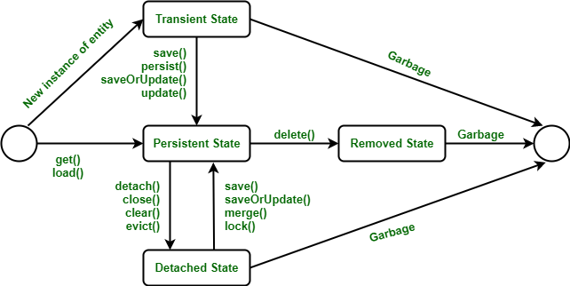
Hibernate Lifecycle
Transient State
Persistent State
Detached State
Removed State

Slide 51

State 1: Transient State
Example:
Employee e = new Employee(); e.setId(21); e.setFirstName("Neha");
The transient state is the first state of an entity object. When we instantiate an object of a POJO class using the new operator then the object is in the transient state. This object is not connected with any hibernate session. As it is not connected to any Hibernate Session, So this state is not connected to any database table. So, if we make any changes in the data of the POJO Class then the database table is not altered. Transient objects are independent of Hibernate, and they exist in the heap memory.

Slide 52
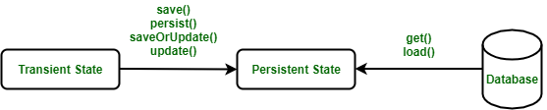
State 2: Persistent State
// Transient State
Employee e = new Employee("Neha Shri Rudra", 21, 180103);
//Persistent State
session.save(e);
Once the object is connected with the Hibernate Session then the object moves into the Persistent State. So, there are two ways to convert the Transient State to the Persistent State :
Using the hibernated session, save the entity object into the database table.
Using the hibernated session, load the entity object into the database table.
In this state. each object represents one row in the database table. Therefore, if we make any changes in the data then hibernate will detect these changes and make changes in the database table.

Slide 53
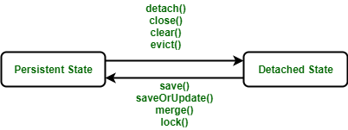
State 3: Detached State
// Transient State
Employee e = new Employee("Neha Shri Rudra", 21, 180103);
//Persistent State
session.save(e);
// Detached State
session.close();
For converting an object from Persistent State to Detached State, we either have to close the session or we have to clear its cache.
As the session is closed here or the cache is cleared, then any changes made to the data will not affect the database table.
Whenever needed, the detached object can be reconnected to a new hibernate session.

Slide 54
State 4: Removed State
// Transient State
Employee e = new Employee("Neha Shri Rudra", 21, 180103);
//Persistent State
session.save(e);
// Removed State
session.delete(e);
In the hibernate lifecycle it is the last state. In the removed state, when the entity object is deleted from the database then the entity object is known to be in the removed state.
It is done by calling the delete() operation. As the entity object is in the removed state, if any change will be done in the data will not affect the database table.

Slide 55
Entity lifecycle
New/Transient
Save/persist
Commit
rollback/new
delete/remove
Removed
Persistent/Managed
refresh
persist/rollback
Commit/rollback/close
Merge
rollback
Detached

Slide 56
Entity operations
Detach → If an entity is detached, then it is not associated with hibernate session.
Merge → merge will reattach an instance to session if it is detached.
Remove → Transitions managed entity to be removed. Next flush/commit will delete from db.
Refresh → Prevents stale data. Reload/synch object with data from db.
Persist → Transitions new instances to managed state. Next flush/commit will save in db.

Slide 57
Summary
We have learned about some important concepts used in database/hibernate such as advanced mappings, entity lifecycle, keys, cascade etc.

Slide 58
Thank You
Proprietary content. ©Great Learning. All Rights Reserved. Unauthorized use or distribution prohibited

